Slide 1
Basic Programming Concepts
Chapter 01
Programming Fundamentals
ITP3915

Slide 2
Lesson Intended Learning Outcomes
Upon completion of this lesson, you should be able to:
  Know basic programming concepts
  Know python basics
  Expressions and Statements

Slide 3
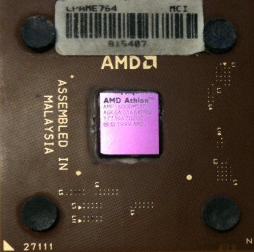





Computers wants to be helpful…
Computers are built for one purpose - to do things for us
But we need to speak their language to describe what we want done
Users have it easy - someone already put many different programs (instructions) into the computer and users just pick the ones we want to use
What
Next?
What
Next?
What
Next?
What
Next?
What
Next?
What
Next?

Slide 4
Users vs Programmers
Users see computers as a set of tools - word processor, spreadsheet, maps, to-do list, email, etc.
Programmers learn the computer “ways” and the computer language
Programmers have some tools that allow them to build new tools
Programmers sometimes write tools for lots of users and sometimes programmers write little “helpers” for themselves to automate a task

Slide 5
Why be a programmer?
To get some task done - we are the user and programmer
Help analyze and process data (many programs have APIs)
To produce something for others to use – write programs
Fix an issue with a program

Slide 6
Why Python
Python is a popular programming language
Its design philosophy emphasizes code readability, and its syntax allows programmers to express concepts in fewer lines of code than possible in languages such as C++ or Java
Python supports multiple programming paradigms, including object-oriented, functional programming or procedural styles

Slide 7
Important Notes
Variable names and keywords in code segments are case sensitive
All wordings must be spelt correctly
Code blocks are separated by indentations instead of curly braces { … } in other programming language, such as C and JAVA
Python Program:
if condition 1:
do stuff in condition 1 if true
do this too since indented
elif condition 2:
do this stuff if condition 1 is false but condition 2 is true
else:
do this stuff if all the conditions in the previous statements were false
JAVA Program:
if (condition 1) {
do stuff inside brackets if condition 1 is true
} else if (condition 2) {
do this stuff if condition 1 is false but condition 2 is true
} else {
do this stuff if all the conditions in the previous statements were false
}

Slide 8
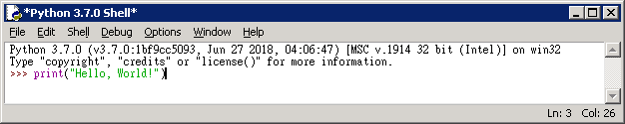
Your very first program
Hello, World!
launch IDLE
Fill it with the following code and press Enter
print("Hello, World!")

Slide 9
Hello, World!
As you can see, the first program consists of the following parts:
  the word print;
  an opening parenthesis;
  a quotation mark;
  a line of text: Hello, World!;
  another quotation mark;
  a closing parenthesis.
Each of the above plays a very important role in the code
print("Hello, World!")
function
argument

Slide 10
String
The only argument delivered to the print() function in this example is a string:
print ("Hello World!")
string is delimited with quotes
Print() can be used with comma (,) and plus (+)
print ("Hello", "World!")
print ("Hello " + "World!")

Slide 11
Statements
x = 2
x = x + 2
print (x)
Assignment Statement
Assignment with expression
Print statement
Variable
Operator
Constant
Reserved Word

Slide 12
Variables
A variable is a named place in the memory where a programmer can store data and later retrieve the data using the variable “name”
Programmers get to choose the names of the variables
You can change the contents of a variable in a later statement
x = 12.2
100
x
12.2
y = 14
y
14
x = 100

Slide 13
Naming Rules
Can consist of letters, numbers, or underscores (but cannot start with a number)
Case Sensitive
Good: spam eggs spam23 _speed
Bad: 23spam #sign var.12
Different: spam Spam SPAM

Slide 14
Reserved Words
You can NOT use reserved words as variable names / identifiers
and del for is raise assert elif
from lambda return break else
global not try class except if or while
continue exec import pass
yield def ﬁnally in print as with

Slide 15
Python Scripts
Interactive Python is good for experiments and programs of 3-4 lines long
But most programs are much longer so we type them into a file and tell python to run the commands in the file.
In a sense we are “giving Python a script”
As convention, we add “.py” as the suffix on the end of these files to indicate they contain Python

Slide 16
Python Shell vs Python Script
Python Shell
  You type directly to Python one line at a time and it responds
Python Script
  You enter a sequence of statements (lines) into a file using a text editor and tell Python to execute the statements in the file

Slide 17
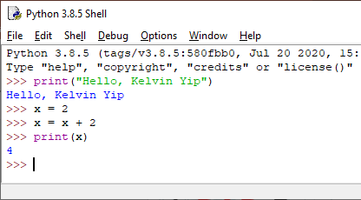
Python Shell Example
>>> is the prompt for you to type statements in python shell
Line of statement would be executed immediately
Some of the statements do not have any outputs

Slide 18
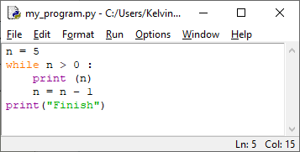
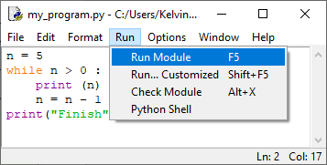
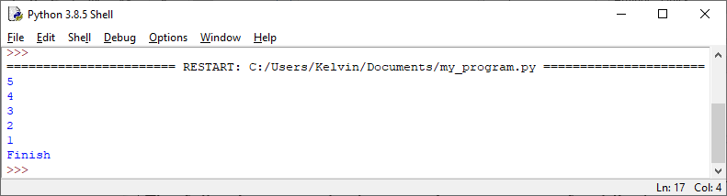
Python Script Example
1. You write all your statements using IDLE, any other editors or IDE (Integrated Development Environment)
2. When finish, you can execute or run your program
3. All statements will be executed one by one. Program output would be displayed in Python Shell

Slide 19
Program Steps and Program Flow
Like a recipe or installation instructions, a program is a sequence of steps to be done in sequence
Some steps are conditional
Sometimes a step or group of steps are to be repeated
Sometimes we store a set of steps to be used over and over as needed several places throughout the program

Slide 20
Sequential Steps
x = 1
print ( x )
x = x + 1
print ( x )
Assigning a value to a variable
x = 1
print ( x )
Performing Arithmetic
x = x + 1
When a program is running, it flows from one step to the next. We as programmers set up "paths" for the program to follow.
print ( x )

Slide 21
Conditional Steps
x = 5
Program
x = 5
if x < 10 :
print ("Smaller")
if x > 20 :
print("Bigger")
print("Finish")
Output
Smaller
Finish
x < 10 ?
Yes
No
print ("Smaller")
x > 20 ?
Yes
No
print ("Bigger")
print ("Finish")
Conditional Steps perform different computations or actions depending on Boolean constraint evaluate to True or False

Slide 22
Repeated Steps
n = 5
Program
n = 5
while n > 0 :
print (n)
n = n – 1
print("Finish")
Output
5
4
3
2
1
Finish
No
n > 0 ?
Yes
print (n)
n = n - 1
print ("Finish")
Loops (repeated steps) have iteration variables that change each time through a loop. Often these iteration variables go through a sequence of numbers.

Slide 23
Stored (and reused) Steps
def hello():
Program
def hello():
print("Hello")
print("Fun")
hello()
print("Happy")
hello()
Output
Hello
Fun
Happy
Hello
Fun
print ("Hello")
print ("Fun")
hello()
print ("Zip")
hello()
We call these reusable pieces of code "functions"

Slide 24
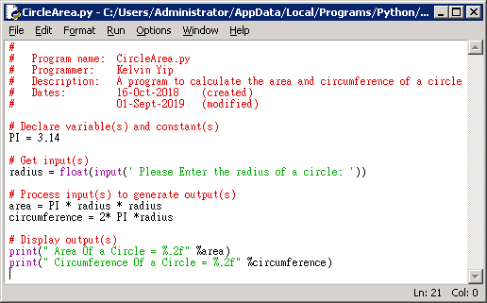
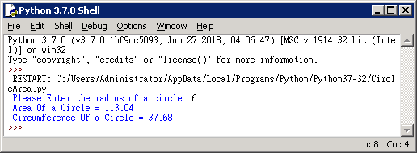
Example of a Simple Program
#
# Program name: CircleArea.py
# Programmer: Kelvin Yip
# Description: A program to calculate the area and circumference of a circle.
# Dates: 16-Oct-2018 (created)
# 01-Sept-2019 (modified)
# Declare variable(s) and constant(s)
PI = 3.14
# Get input(s)
radius = float(input(' Please Enter the radius of a circle: '))
# Process input(s) to generate output(s)
area = PI * radius * radius
circumference = 2* PI *radius
# Display output(s)
print(" Area Of a Circle = %.2f" %area)
print(" Circumference Of a Circle = %.2f" %circumference)

Slide 25
References
References:
  James Parker, Mercury Learning (2017). Python: An Introduction to Programming
  Kristian Rother, Apress (2017). Pro Python Best Practices: Debugging, Testing and Maintenance

Slide 26
End

